Slide 1
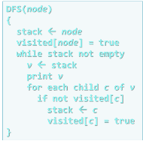
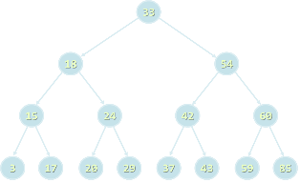

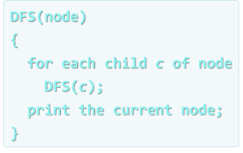


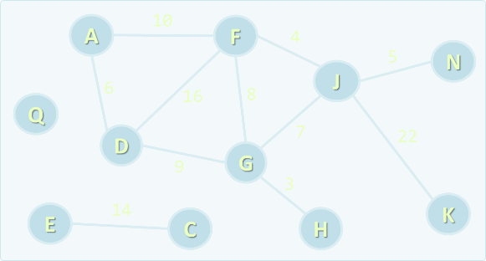
Algorithms Course
Curriculum, Trainers, Evaluation, Exams
Algorithms
SoftUni Team
Technical Trainers
Software University
http://softuni.bg

Slide 2

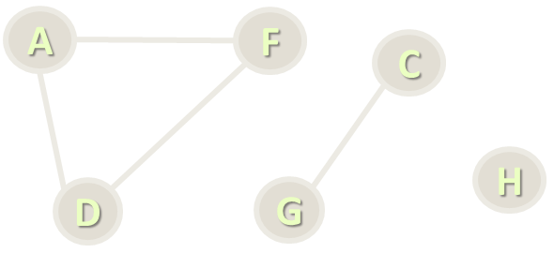
Table of Contents
Course Objectives
Course Program
Trainers Team
Examination
Learning Resources

Slide 3

Algorithms
Course Objectives & Program

Slide 4

Part I: Data Structures – Course Program
Course Overview
Data Structures, Algorithms and Complexity
Linear Data Structures – Lists
Linear Data Structures – Stacks and Queues
Trees and Tree-Like Structures
Tree Traversal Algorithms – BFS and DFS
Dictionaries and Hash Tables

Slide 5
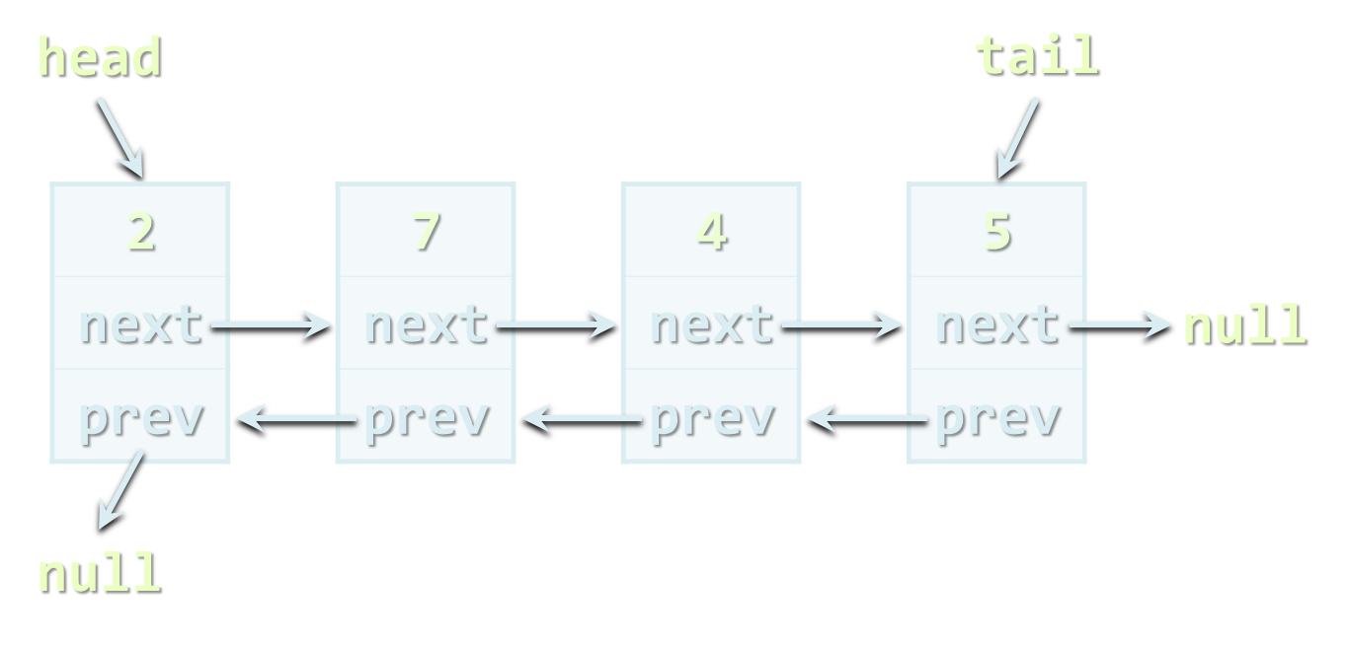


Part I: Data Structures – Course Program (2)
Data Structure Collections & Libraries
AVL, Red-Black, AA trees, Ropes
B-Trees, QuadTree, k-d Trees, Interval Trees
Exam Preparation
Practical Exam

Slide 6

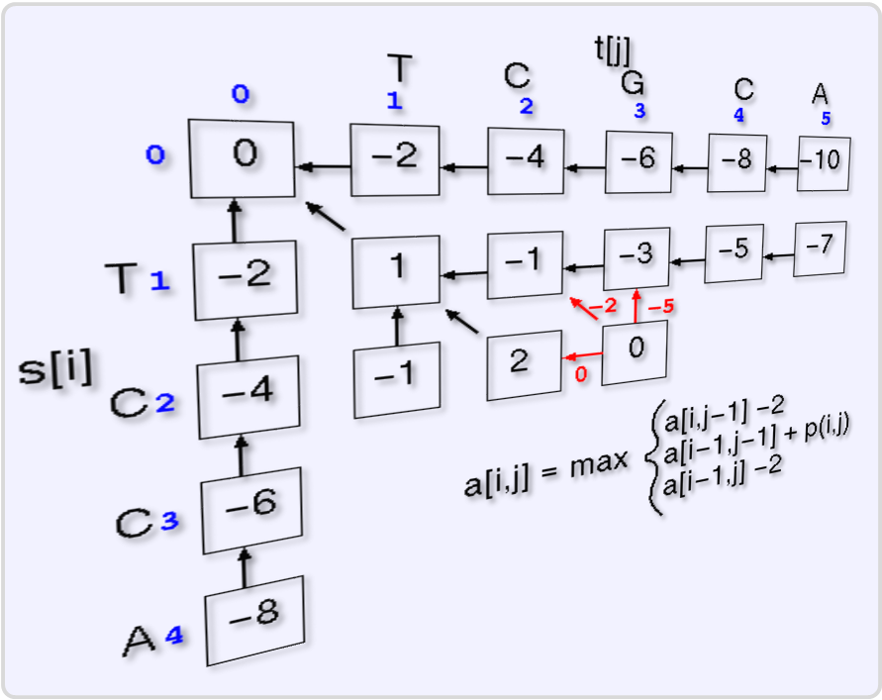
Part II: Algorithms – Course Program
Recursion and Recursive Algorithms
Combinatorial Algorithms
Sorting and Searching Algorithms
Dynamic Programming
Graphs and Graph Algorithms
Advanced Graph Algorithms – Part I
Advanced Graph Algorithms – Part II
Greedy Algorithms

Slide 7


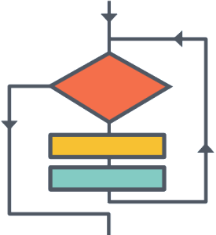
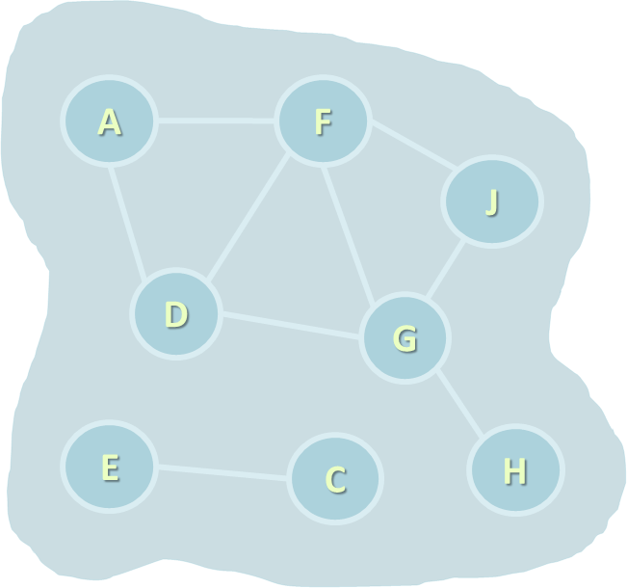

Part II: Algorithms – Course Program (2)
Problem Solving Methodology
Exam Preparation
Practical Exam

Slide 8

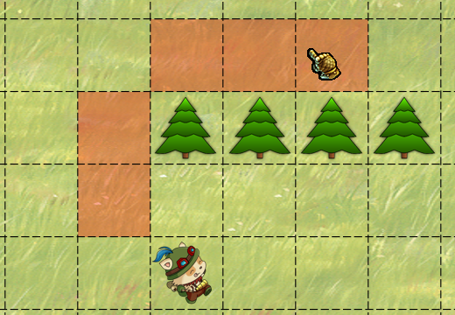
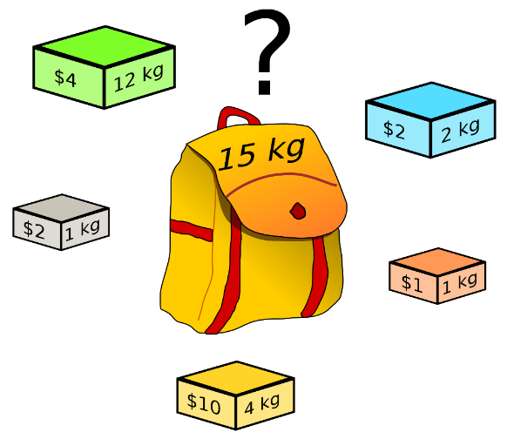
Problems We Will Be Solving
Combinations of Cards
A* Pathfinding Algorithm
Knapsack Problem

Slide 9

Problems We Will Be Solving (2)
IDEs
conditionals
variables
loops
Articulation Points
bits
6
17
4
20
1
10
6
5
11
6
5
s
5
33
9
Topological Sorting
0
11
20
26
12
3
9
3
8
14
2
15
7
Dijkstra's Shortest Path

Slide 10

The Trainers Team

Slide 11
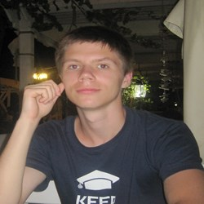
Trainers Team
Atanas Rusenov
Technical Trainer @ Software University
Top performing student from the Software University (2014)

Slide 12
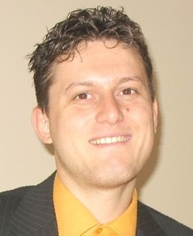
Trainers Team
Svetlin Nakov, PhD
Training & Inspiration Manager @ Software University
20+ years software development experience
10+ years experience as trainer
Author of 7 programming books
Winner in International programming contests and Olympiads
Speaker at hundreds of events
Web site & blog: www.nakov.com

Slide 13

Algorithms: More Details
Duration, Course Format, Languages

Slide 14


Course Duration
Lessons: ~ 18 hours (onsite + YouTube videos)
Practical exercises (in class): ~ 18 hours
Exam preparation: 4 hours
Homework: ~ 30-50 hours
Schedule: April – May 2016
Practical exam: 15 May 2016

Slide 15
Programming Languages
Course attendees can use their favorite programming language:
C#, Java, C++, Python / other
The recommended language for this course is C#
Exercises in class assume you will write in C# + Visual Studio
Labs and examples will also focus mostly on C# and Visual Studio
At the final exam attendees can use:
C#, Java or C++

Slide 16



Why English?
Why the slides are in English
English is the native language of software engineers
Specific terminology should be in English
Translations are inaccurate and funny
Just learn English!
No excuses

Slide 17
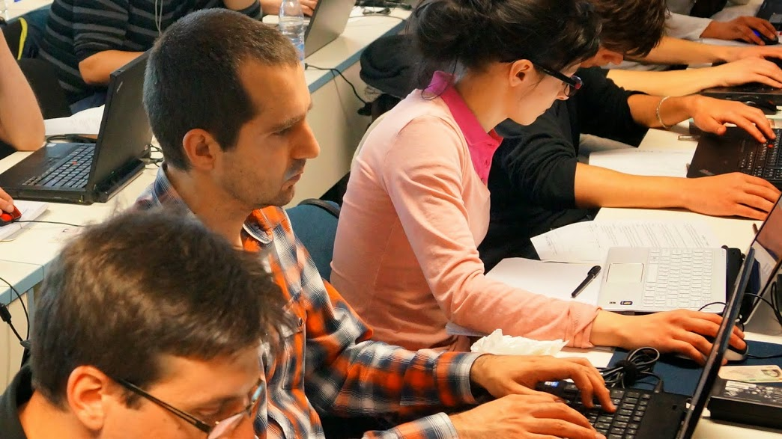


Algorithms
Evaluation Criteria

Slide 18
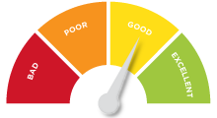

Scoring System for the “Algorithms“ Course
Practical exam
90%
Homework + evaluation
5% + 5%
Contribution in the forum:
Up to 10% bonus

Slide 19


Practical Exam
The practical exam checks your skills to design and implement algorithms efficiently
4 problems for 6 hours
Graphs, dynamic programming, recursion, combinatorics, greedy, …
Automated judge system with real-time feedback: http://judge.softuni.bg

Slide 20

Homework Assignments
Doing your homework is very important!
Programming can only be learned through a lot of practice!
You should write code every day!
Each lecture is followed by a few exercises
Try to solve them in class
The rest are your homework
Homework assignments are due in 1-2 weeks after each lecture
Submissions will be accepted through our web site: softuni.bg

Slide 21


Homework Peer Reviews
Give feedback to a few random homework submissions
Students submit homework anonymously
Please exclude your name from the submissions!
For each homework submitted
Students evaluate 3 random homeworks
From the same topic, after the deadline
Give written feedback, at least 200 characters
Low-quality feedback → report for punishment
Everyone will get feedback for their homework

Slide 22





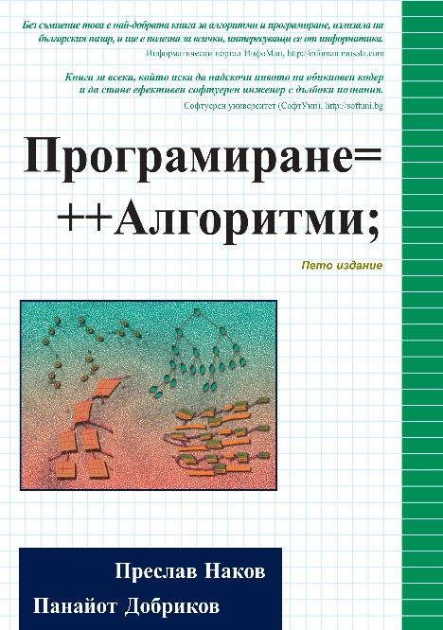



Resources
What Else Do We Need?

Slide 23

Course Web Site & Forums
The Algorithms course official Web site:
Register for the "Software University Forum":
Discuss the course exercises with your colleagues
Find solutions for all course exercises and labs
Share source code / discuss ideas / help each other
https://softuni.bg/trainings/1331/algorithms-april-2016
https://softuni.bg/forum

Slide 24



Slides and Videos
All lecture slides, videos, homework assignments, labs and other resources are open content, available for free
Visit the course web site to access the course resources

Slide 25

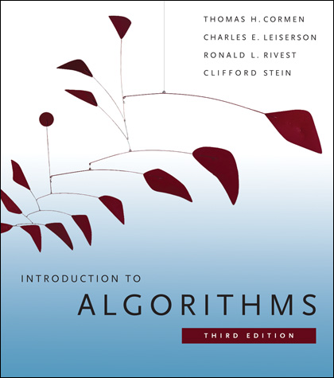
Algorithms – Additional Resources
Nakov P., Dobrikov P., "Programming = ++ Algorithms;", 5th Edition, ISBN: 954-8905-06-X, Faber Publishing (2015)
Download a free copy from: www.programirane.org
No English version (Bulgarian only)
Cormen T., Leiserson C., Rivest R., Stein C., "Introduction to Algorithms", 3rd Edition, ISBN 978-0262033848, MIT Press (2009)
Find the book in Internet: https://goo.gl/ElgQD3

Slide 26
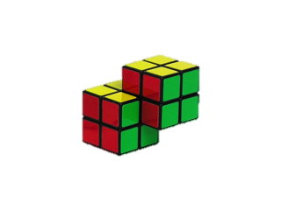
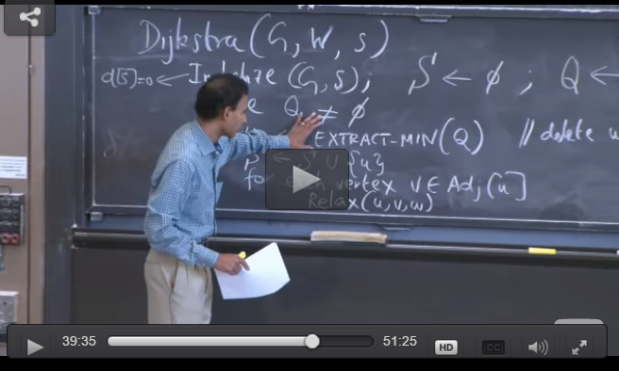
Algorithms – Additional Resources (2)
Introduction to Algorithms MIT course
http://www.geeksforgeeks.org/fundamentals-of-algorithms/
6
17
4
20
1
10
6
5
11
6
5
s
5
33
9
0
11
20
26
12
3
9
3
8
14
2
15
7

Slide 27
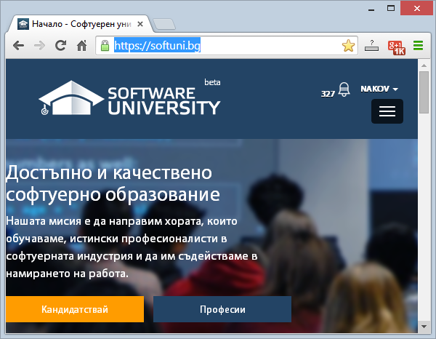
Software University Learning System (SULS)
Software University Learning System (SULS)
www.softuni.bg
Important resources for students
Homework submissions
Homework check-up
Exams and results
Discussion forum
Reports about your progress

Slide 28
Recommended Software
Visual Studio Community 2015
Or another C# development environment
SharpDevelop – lightweight IDE for C#
Xamarin Studio – powerful IDE for C# / .NET for Linux, Mac OS X, Windows and others
Eclipse / IntelliJ IDEA (for Java)
Code::Blocks (for C++)

Slide 29








Algorithms – Course Introduction
https://softuni.bg/trainings/1331/algorithms-april-2016

Slide 30
License
This course (slides, examples, labs, videos, homework, etc.) is licensed under the "Creative Commons Attribution-NonCommercial-ShareAlike 4.0 International" license
Attribution: this work may contain portions from
"Fundamentals of Computer Programming with C#" book by Svetlin Nakov & Co. under CC-BY-SA license
"Data Structures and Algorithms" course by Telerik Academy under CC-BY-NC-SA license

Slide 31






Free Trainings @ Software University
Software University Foundation – softuni.org
Software University – High-Quality Education, Profession and Job for Software Developers
softuni.bg
Software University @ Facebook
facebook.com/SoftwareUniversity
Software University @ YouTube
youtube.com/SoftwareUniversity
Software University Forums – forum.softuni.bg

